Slide 1
Improving Developer Experience with Github Codespaces
Using a web-based IDE to speed onboarding and standardize developer environments.
Initial test results, not an endorsement
Michael Chelen
Health Engineering Lead, Office of the CTO
Department of Veterans Affairs
michael.chelen@va.gov
https://github.com/mchelen-gov
Version 1.0.0
2020-12-15

Slide 2
Developer Experience pain points
Onboarding
  Time to first commit
Standardization
  “It works on my laptop”
Tooling
  Debuggers > console.log()

Slide 3
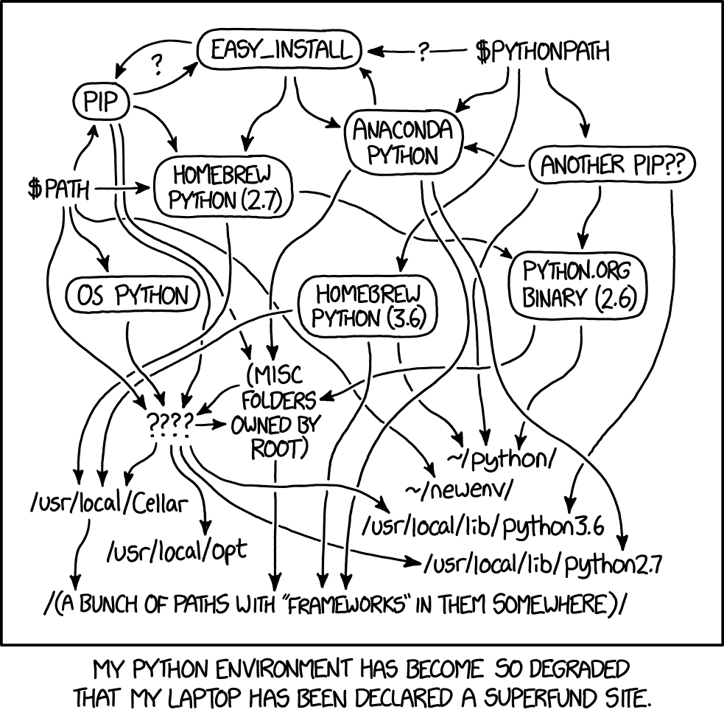
Onboarding Developers
Slow
  Many codebases
  Many setup steps
Difficult
  Many operating systems
  Many languages
Example: VA
  vets-website - NodeJS/React
  vets-api - Ruby/Rails
  va.gov-cms - PHP/Drupal
Best case: one language with one operating system
Source: https://xkcd.com/1987/

Slide 4
Standardization and Tooling
Environment matching
  Local dev = CI = Stage = Prod
Reproduce between developers

Slide 5
Existing Approaches and challenges
Good documentation
  Well defined setup steps for new developers to follow
  Keeping docs updated creates overhead, docs must cover all needed OS combos
Scripts
  Automatically sets up environment or codebase
  Scripts must account for different OS or environments, handle errors gracefully
Containerization
  Run software stack in Docker
  Integration with local filesystem, IDE, debugger
Shared config
  Lint config, Editorconfig, extension config can be shared in repo
  Config may vary depending on IDE and OS environment
Notes:
Scripts can be more confusing if something errors and system is in intermediate state
Scripts & Docker depend on setup of underlying tooling

Slide 6
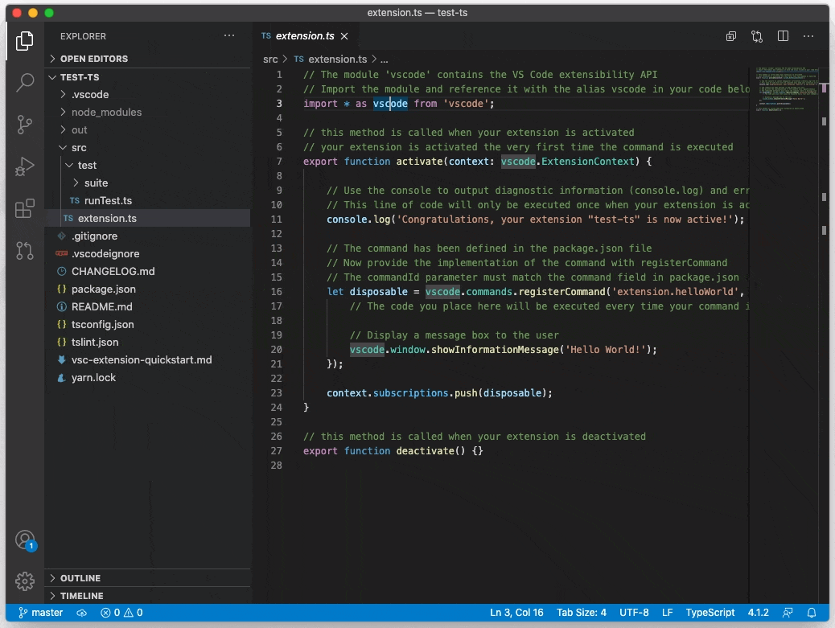
Visual Studio Code (VS Code)
  Popular open source IDE
    #1 in Stack Overflow 2019 survey
  Supports many programming languages
  Official and community created extensions
  Cross platform (Mac, Win, Linux, + Web!)
VS Code 1.52

Slide 7
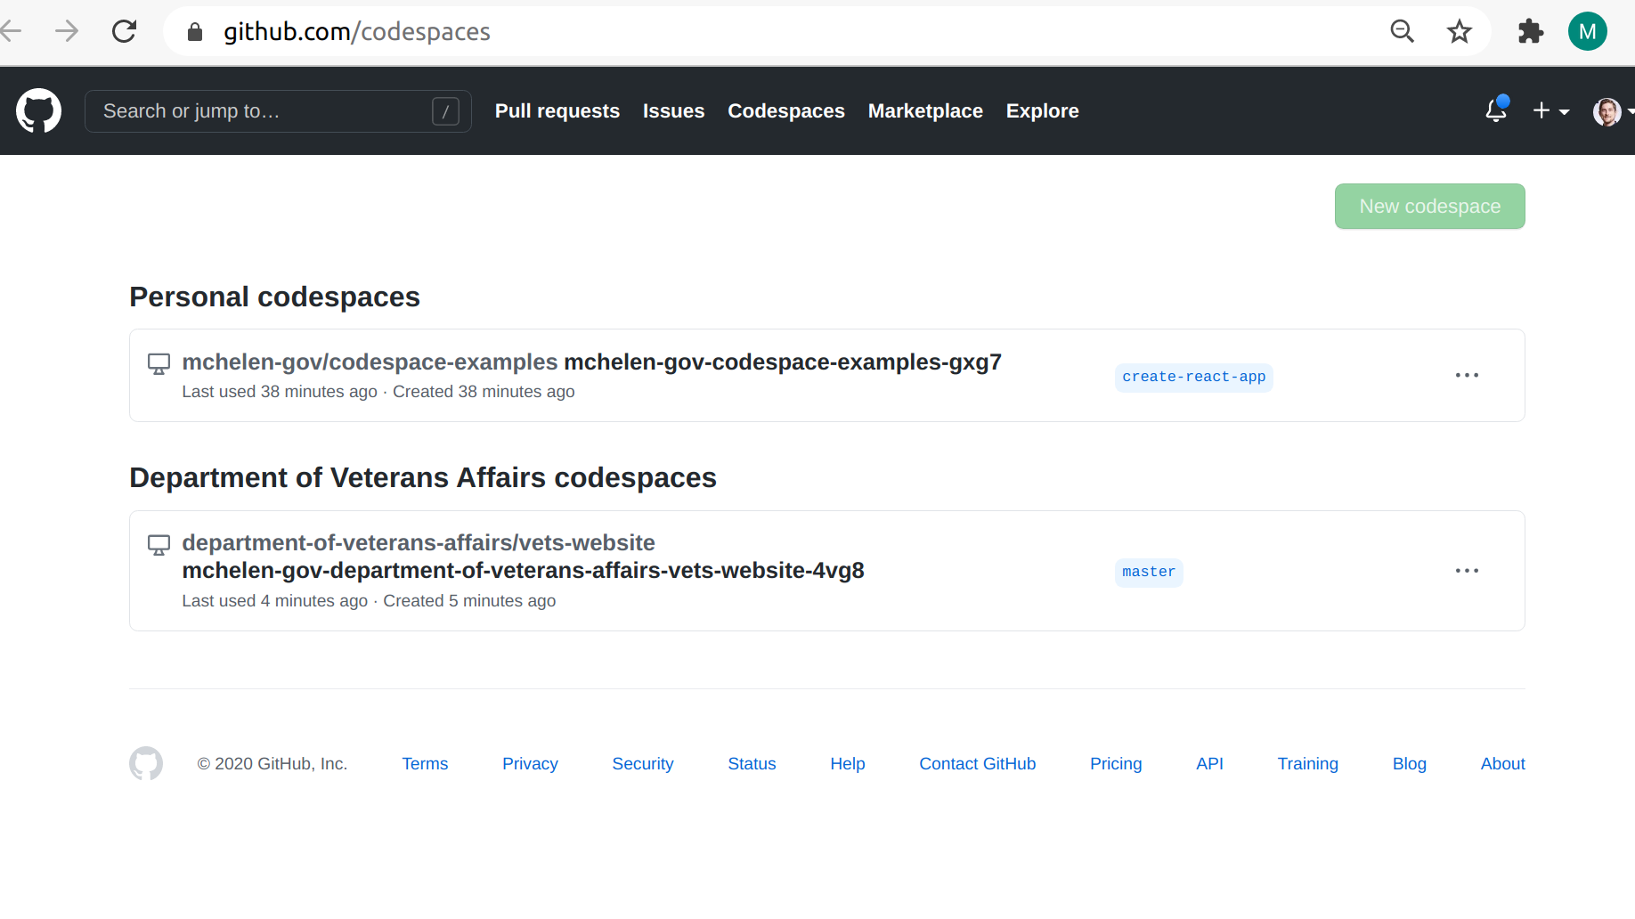
Github Codespaces
Codespaces is a web based version of VS Code
UI entirely browser based
Backend runs in Azure container
Config can be stored in Github repo
VA is participating in closed beta https://github.com/features/codespaces

Slide 8

Start a new Codespace
Dropdown menu option
Create and build container
Start IDE web UI
Run startup scripts
Progress visible in logs
Notes:
go to repo
click “code”
create new codespace
wait for spin up

Slide 9
Running application server
App and toolchain are ready once startup completes
Follow README to start app
Application port is forwarded, load in new tab
Edit code to see live updates

Slide 10
Disconnect and reconnect to Codespace
Closing browser window preserves IDE session
File and environment changes are preserved when Codespace is inactive
Codespace can be deleted and recreated as needed

Slide 11
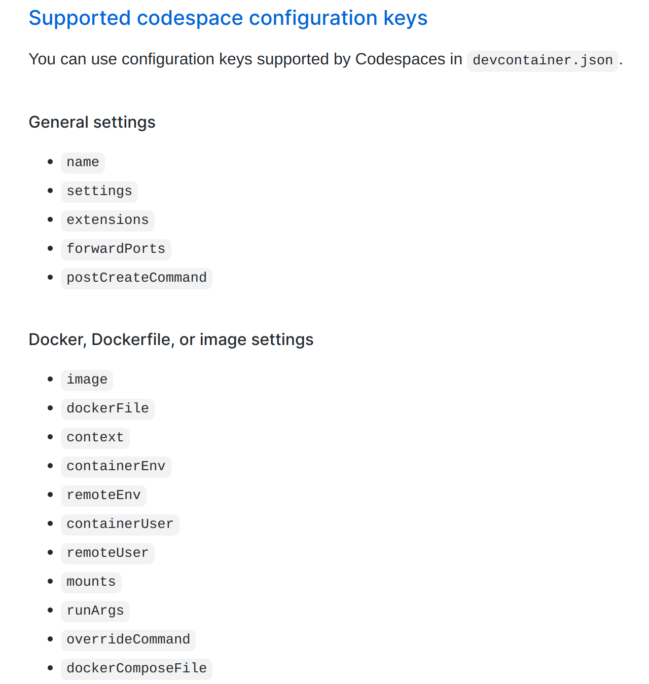
Shared configuration
devcontainer.json
IDE Settings
Extensions
Docker
  container, services, and env
Port forwarding
Startup scripts

Slide 12
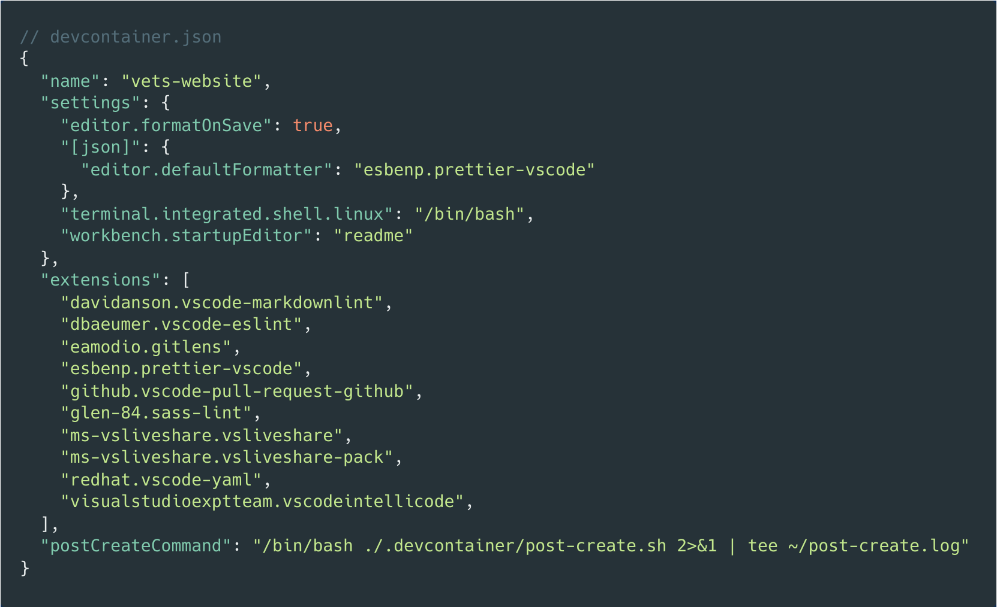
Shared config: IDE settings and extensions
Default settings
  Format on save
  Default formatter
  Default shell
  Can be overridden by user
Helpful extensions
  Linting (ESLint, SASS, YAML)
  Formatting (Prettier)
  Collab tools (Liveshare, Gitlens)
Notes:
extensions can be selected based on code and team needs

Slide 13
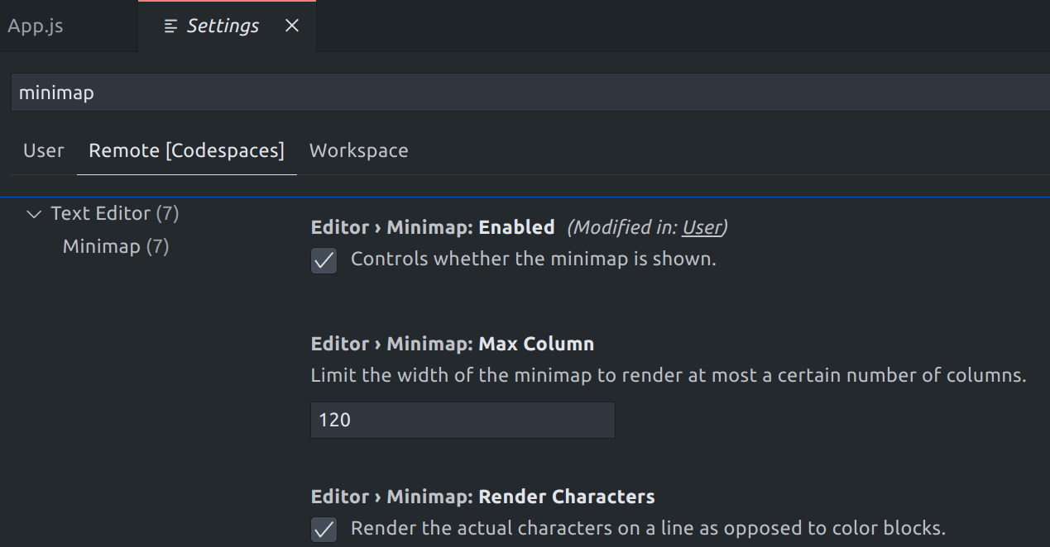
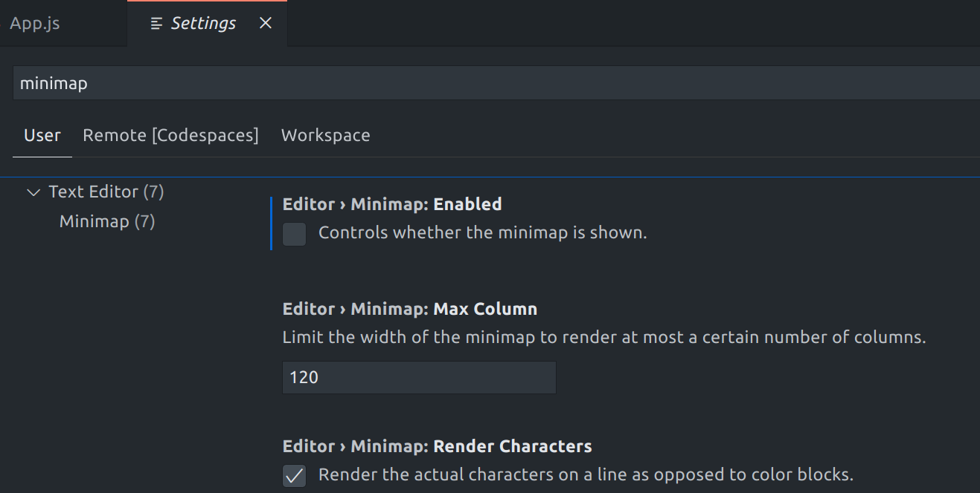
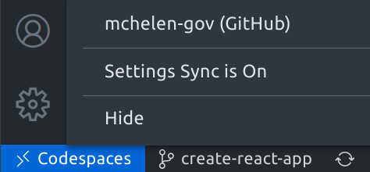
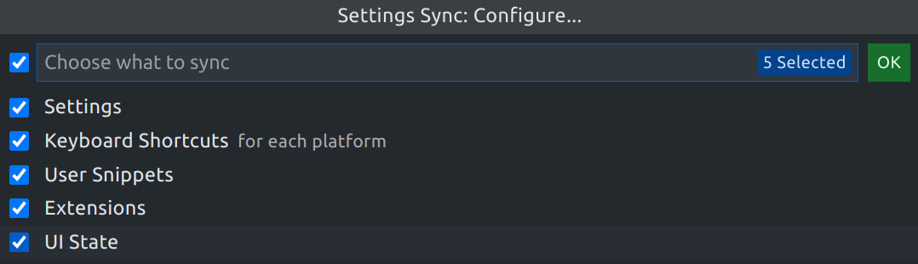
User Customization
User settings override shared settings
User settings synchronized through Github account
Also supports dotfiles

Slide 14
Results
Decrease onboarding difficulty
  More automation
  Default environment allows simpler docs
Standardize dev environment
  Problems can be reproduced and fixes captured in repo
Increase dev tool availability
  Shared settings allow reusable tool config

Slide 15
Next steps
Test setup for different codebases
  React, Ruby, PHP
  Configure software stack, scripts, tooling
Multi-repo dependencies
  Determine best approach for running FE (vets-website) and BE (vets-api) together
Unify container config with CI and hosting

Slide 16
Further Research
Share settings with local IDEs
Compare with other cloud IDEs
Investigate performance
  Standard instance ( 4 cores, 8 GB RAM, 32 GB SSD) struggles with some applications
Use for development on GFE
  Containerize & mock internal services
  Firewall and proxy options

Slide 17
Live Demo 🤞
Using:
https://github.com/mchelen-gov/codespace-examples/tree/create-react-app

Slide 18
Q&A

